Slide 1

MicrobeJ & Its Applications
姚遠 洪承郁 劉天祐

Slide 2
Paper information
MicrobeJ, a tool for high throughput bacterial cell detection
and quantitative analysis
https://www.nature.com/articles/nmicrobiol201677.pdf

Slide 3
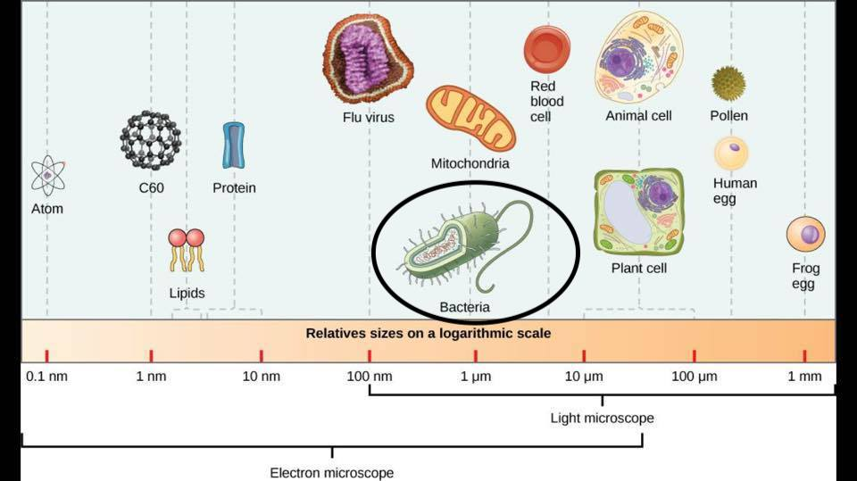
Challenges for automated analysis of bacterial cells’ shape and behavior patterns
1. Small size (≈1 µm)

Slide 4
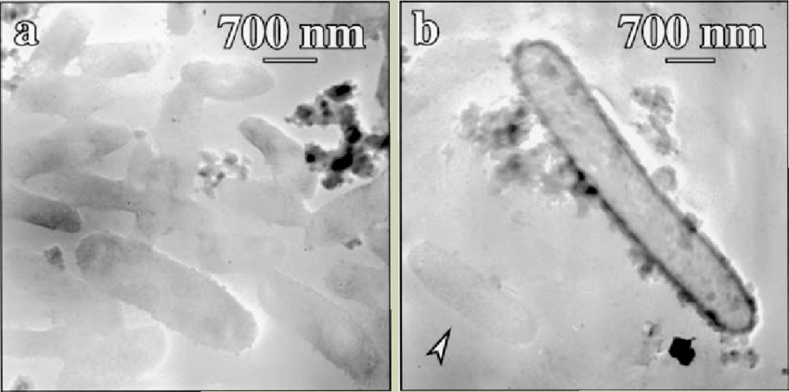
2. (1) Low contrast
=> Hard to distinguish cells from background particles.
(Low contrast) (High contrast)

Slide 5
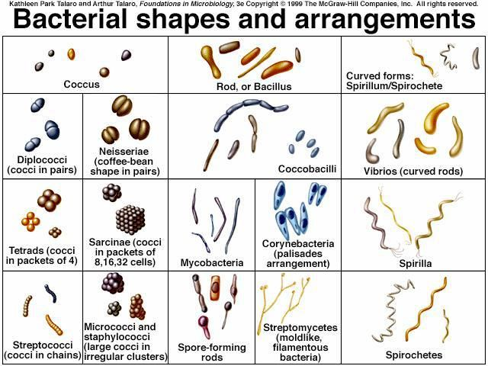
(2) Irregular morphologies.

Slide 6
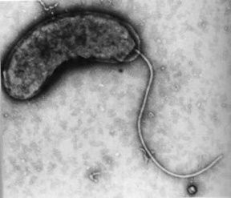
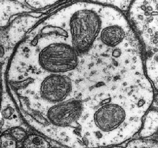
3. Have flagella and organelles that are difficult to
detect and measure.
(Flagella) (Organelles)

Slide 7
Available tools and their issues

Slide 8
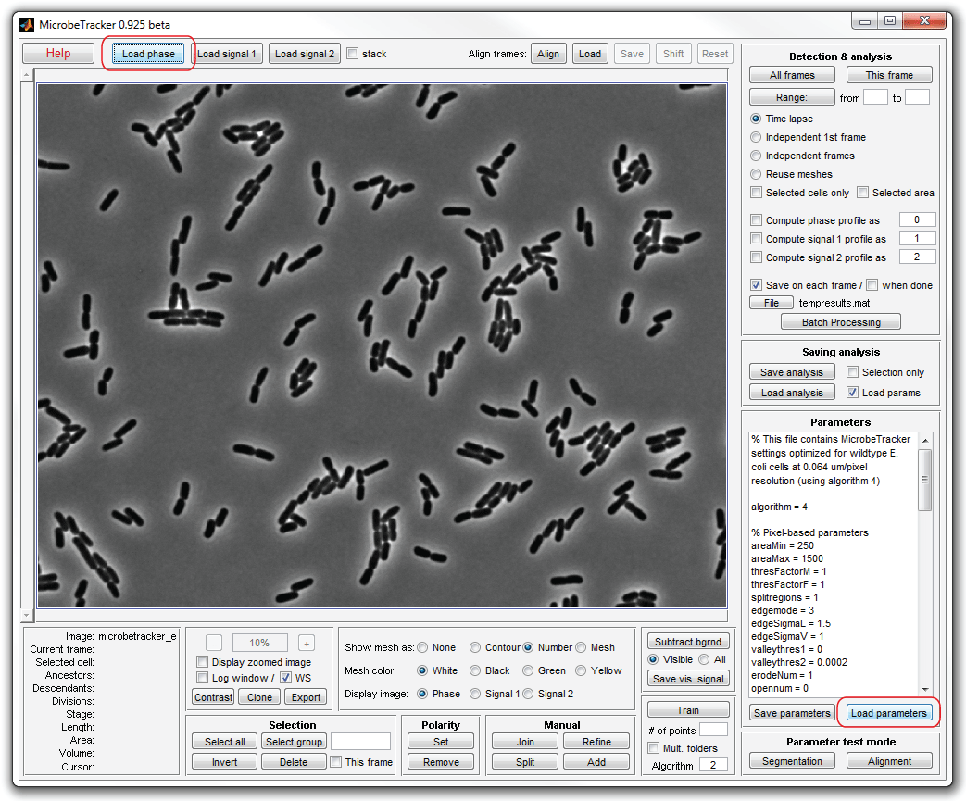
Matlab based:
MicrobeTracker
Problems:
1. Not easy to understand the meaning of segmentation
input values and effects on resulting output.
2. Not developed to deal with images.

Slide 9
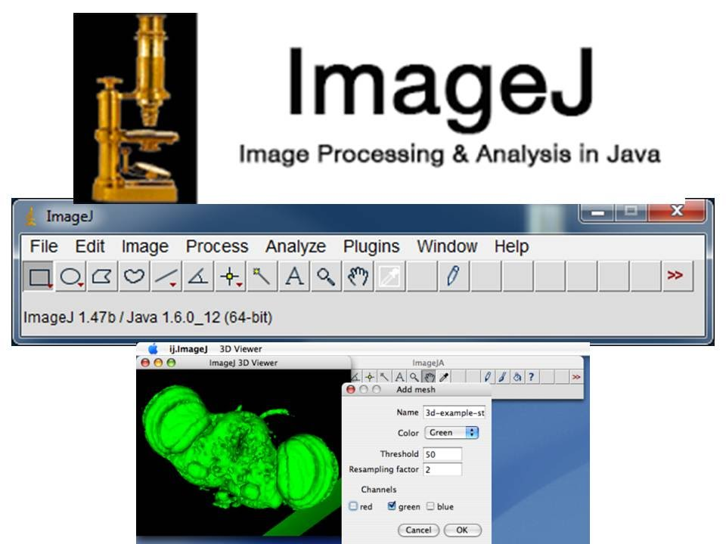
ImageJ based:
Coli-Inspector
Problems:
1. Limited automation.
2. Relies on manual detection to delineate cells on micrographs.

Slide 10
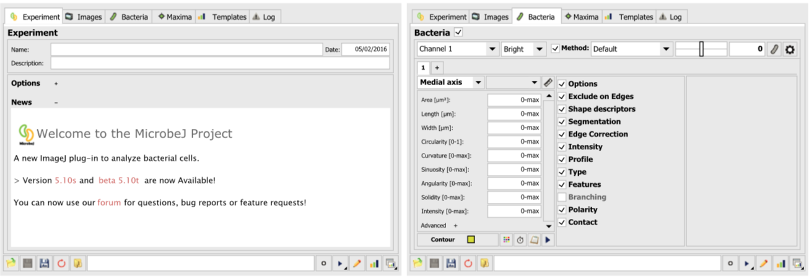
MicrobeJ: A plug-in for ImageJ

Slide 11
So what is MicrobeJ capable of ?

Slide 12
1. Has an interactive graphical user interface (GUI) that:
(1) Generates interaction between image sets, data and
processed output, ensuring accuracy so that users
can determine the best detection parameters.
(2) Can handle high-throughput time-lapse microscopy
experiments.

Slide 13
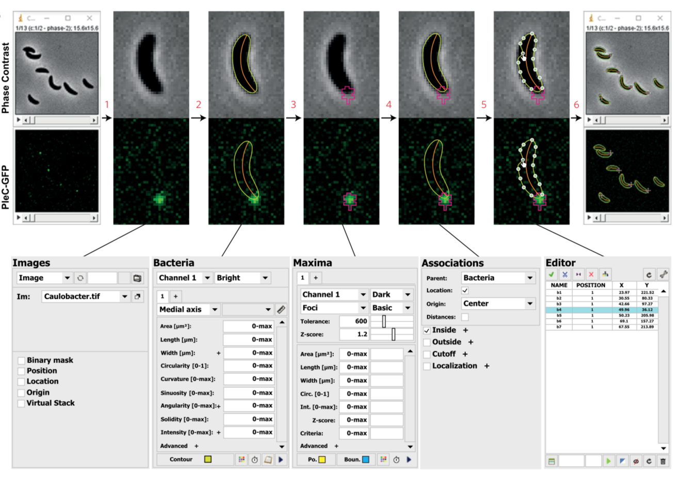
GUI

Slide 14
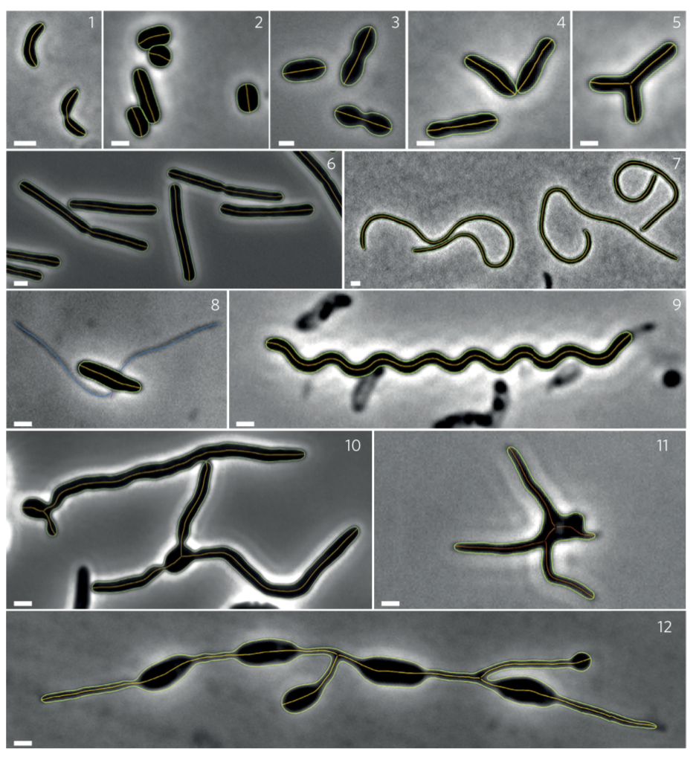
2. (1) Can detect all morphologies,
show subpixel resolution
contours (green) and draw
medial axes (orange).

Slide 15
(2) Automatically detects all shapes of particles.
(3) According to cells’ properties and attributes, inappropriate
particles will be rejected by the system.
(4) Medial axes allow determination of properties like length,
width, angularity and so on.

Slide 16
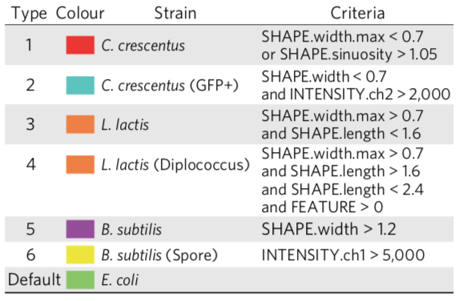
3. (1) Offers a semantic to compute, for example, the
average value of width measured along medial axes
of a particular particle via specific commands.

Slide 17
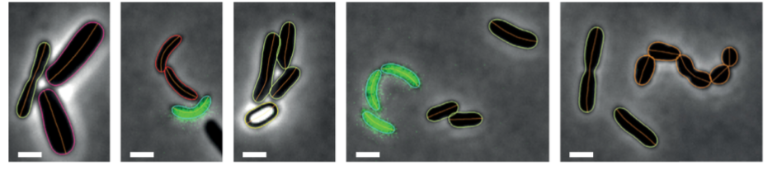
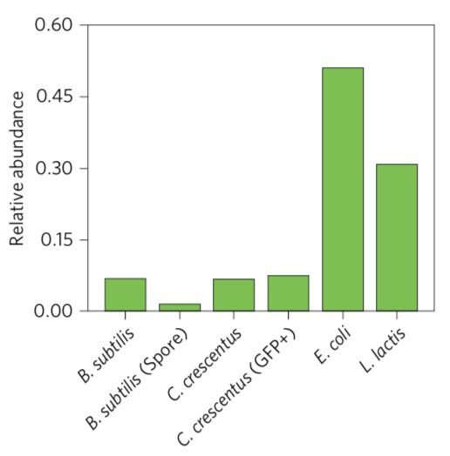
(2) This semantic helps users define criteria to separate
different cellular types and determine relative abundance.

Slide 18
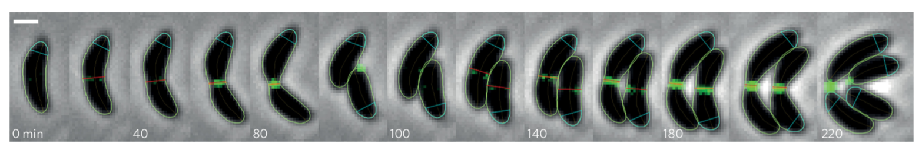
4. (1) Defined criteria can be used for temporal events so as to
evaluate particle properties throughout the experiment.
(Time-lapse images of Caulobacter crescentus cells harbouring FtsZ-YFP
and their respective localization and cell constriction in the cell cycle)

Slide 19
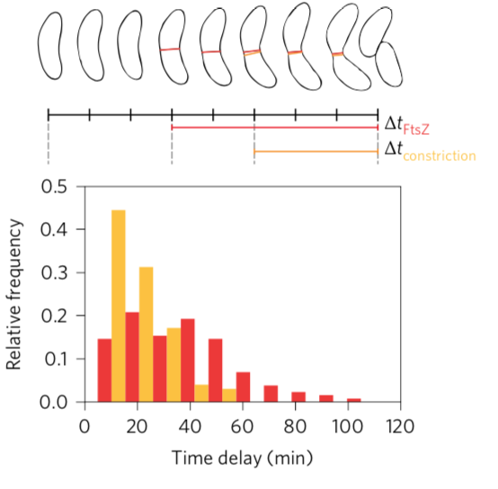
(2) If the particle satisfies criteria made
by users, both the absolute and
relative timing are recorded.
(In this case, the two defined events are the
first appearance of a FTsZ-YFP fluorescent
septum and constriction, which are marked
in red and orange, respectively.)

Slide 20
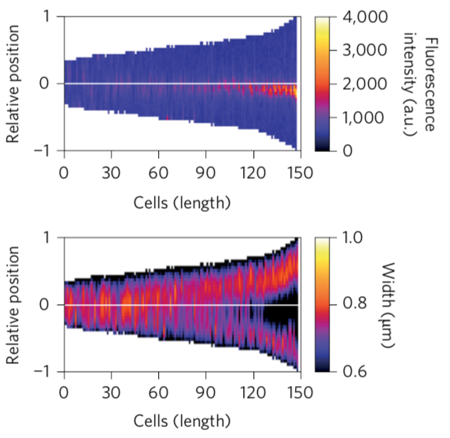
(3) Pixel intensity and width are
measured along medial axis
and used to produce an
oriented map called demograph.
(Cells are sorted based on length. The Y axis means relative position along cell body where 0 represents mid-cell and 1 or -1 the cell poles.)

Slide 21
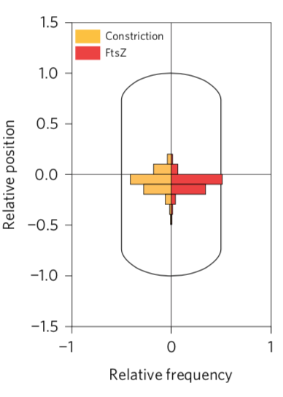
(4) Sub-cellular localization of septa,
constrictions and their distribution
relative to the cell center are plotted
in localization charts.

Slide 22
5. (1) Users can set specific attributes to exclude inappropriate
particles while including missed ones. Rejected particles
will be automatically segmented.

Slide 23
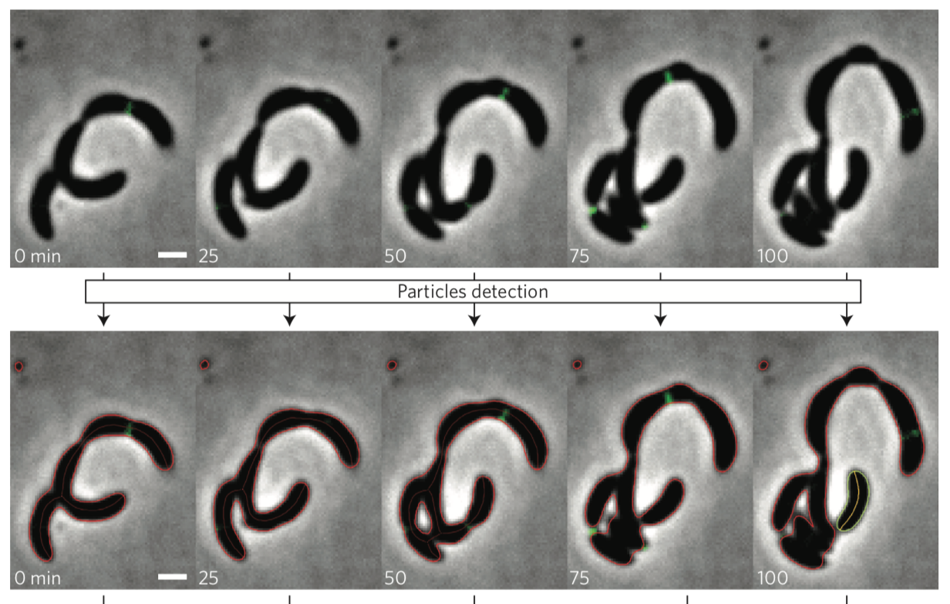
(Before automated segmentation. Rejected particles are in red
while accepted ones are in green.)

Slide 24
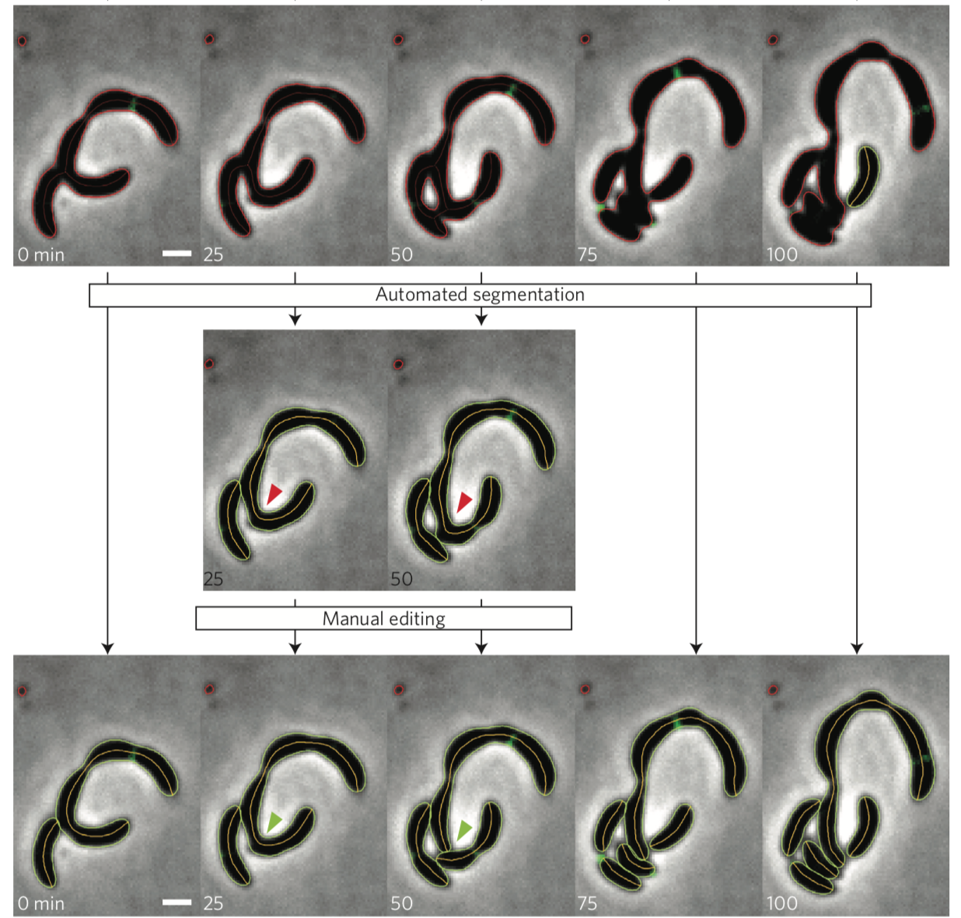
(After automated segmentation)

Slide 25
(2) Under bad resolution, error and inaccuracy appear in contour
detection or particle segmentation. Thus, MicrobeJ offers
manual correction.

Slide 26
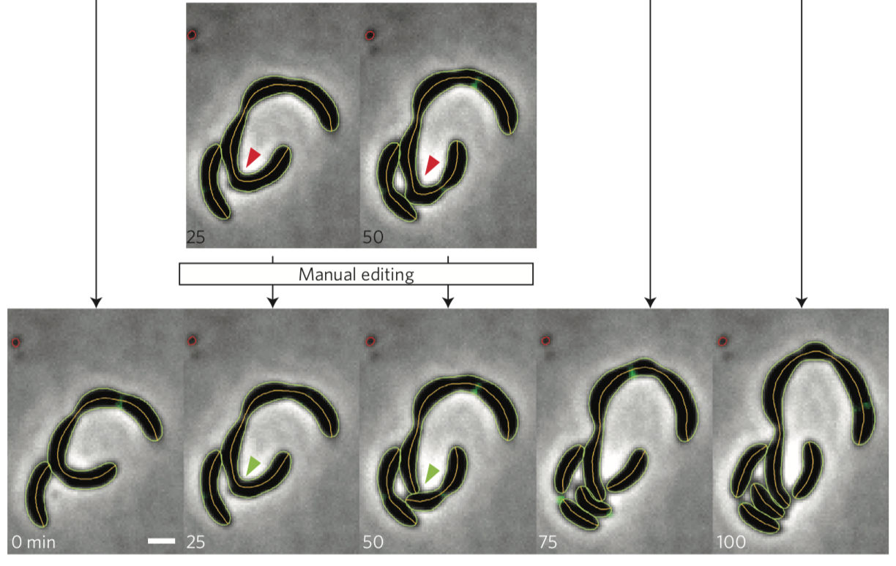
(Red arrows point out cells needing manual correction, and green arrows show the results after correction.)

Slide 27
6. (1) Once the analysis is finished, there is a results interface
combining experiment information, detected particles
and complementary data according to user-selected options.

Slide 28
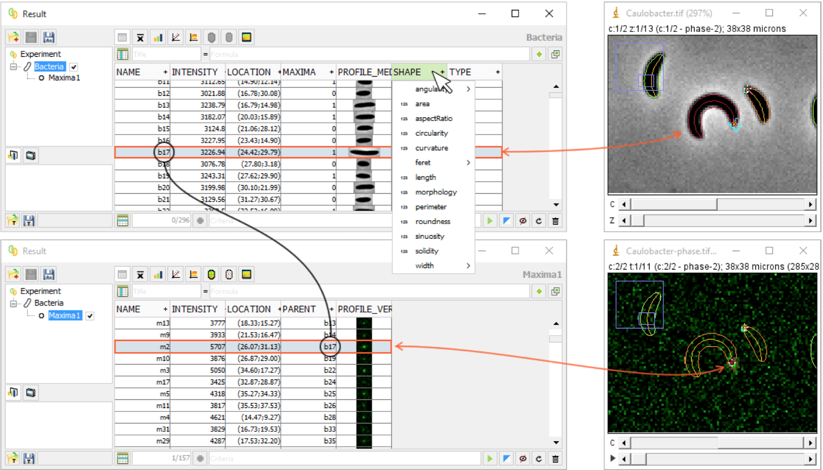

Slide 29
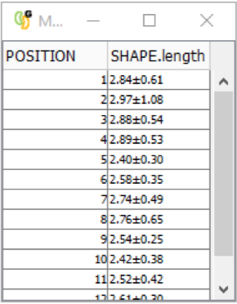
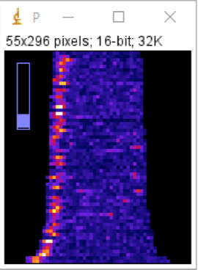
(2) Other presentations of the interface:
(Common statistical analysis) (Fluorescence profiles)

Slide 30
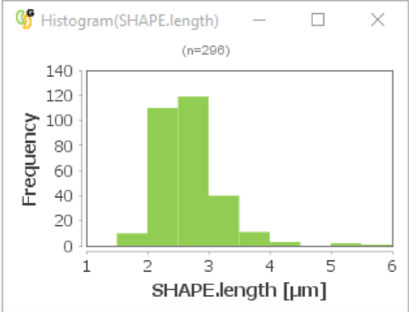
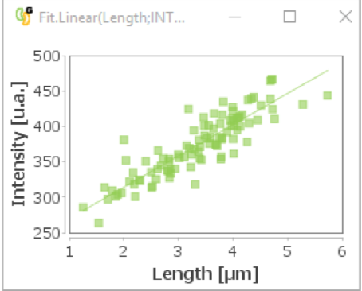
(Interactive charts) (Regression analysis)

Slide 31
Q&A Time

